Slide 1
GO!
🏃‍➡️🏃‍♂️‍➡️🏃‍♀️‍➡️
–by Zelong Xu

Slide 2



When we say “GO”, what comes in to your mind?
🧐

Slide 3
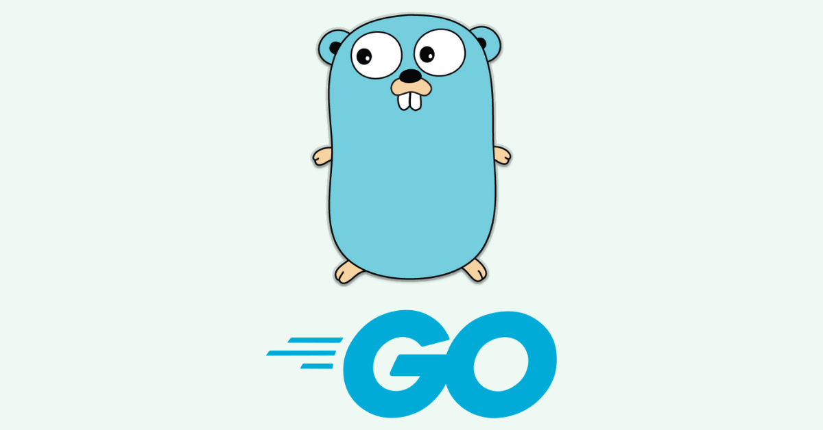
😍
🤩
🥳
PHER??
Notes:
But no, today we are talking about the programming language GO, here is its mascot the “gopher”. Maybe they choosed it because of the name? Who knows.

Slide 4
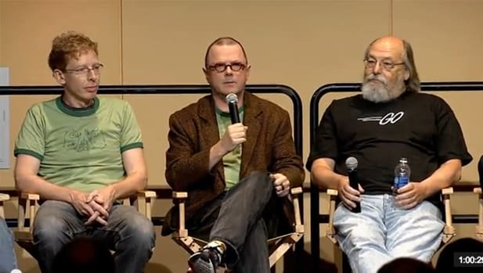


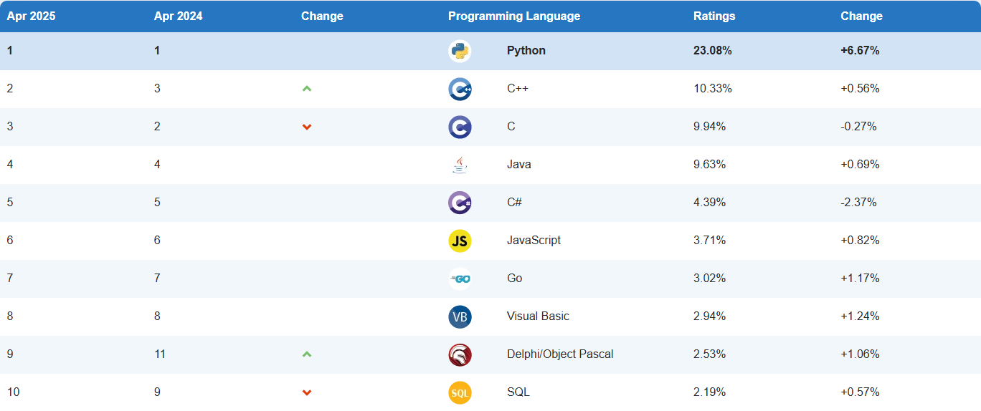

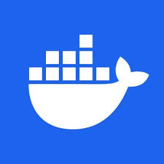
Robert Griesemer,Rob Pike,Ken Thompson
🏆
Language of the Year
(2009)
Invented in 2007
Cloud Native Technology
Notes:
"The Go language was first created in 2007 and was jointly developed by Google engineers Robert Griesemer, Rob Pike and Ken Thompson. Its goal is to replace C++, which was widely used in large systems at the time but had problems such as slow compilation and complex language, and provide a simple, efficient and concurrency-friendly programming language."
"In 2009, Go was officially open source and quickly gained favor in the developer community. In the same year, it won the TIOBE 'Language of the Year' award and became one of the most popular new languages."
"After entering 2016, with the rise of cloud native technologies such as Kubernetes and Docker, Go became their main implementation language because of its **fast compilation, lightweight deployment, and native support for concurrency**."
"From 2023 to now, Go has become one of the mainstream development languages ​​and is widely used in backend services, DevOps tool chains, blockchain systems, and even artificial intelligence (AI) interface development."
"It can be said that Go has not only changed the way we write system software, but also continued to promote the development of modern software engineering."

Slide 5
Why GO??
🤔
✅ Simplicity: clean syntax, no complex syntax such as inheritance and polymorphism, low learning cost
⚡ Concurrency: built-in goroutine and channel, easy to write high-concurrency programs
🚀 Performance: running speed is close to C language after static compilation, suitable for writing high-performance backends
📦 Standard Library: comes with network, file, encryption and other libraries, ready to use
🔧 Easy Deployment: compile a cross-platform executable file with one line of command, easy to deploy
Notes:
"So, what is so special about Go? I can summarize it into five keywords."
"First, simplicity. Go removes many complex grammatical structures in traditional languages, such as class inheritance and generics (which were not added until Go 1.18). The code looks more like 'simple and efficient pseudocode', which is very suitable for team collaboration."
"Second, concurrency. Go natively supports goroutine and channel, making concurrent programming very natural. Compared with thread pool, goroutine is lighter and can easily create thousands of goroutines per second."
"Third, performance. Go is a statically compiled language. The compiled execution speed is very fast, almost close to C language, so it is very suitable for high-performance backend services."
"Fourth, the standard library is powerful (Rich Standard Library). Go comes with HTTP server, JSON encoding and decoding, file operations and other functions. You can develop a complete project without installing a large number of third-party packages."
"Finally, easy deployment (Easy deployment) Deployment). Go programs can be directly compiled into a single binary file. There is no need to install an interpreter or runtime environment. You can just copy it to the server and run it. Cross-platform deployment is also easy.

Slide 6



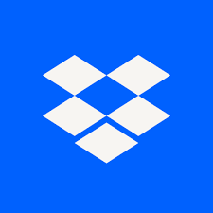
So who is using GO?
Notes:
As mentioned just now, Docker, the platform for containerizing applications. Docker chose Go because of its simple syntax, excellent performance, and built-in support for concurrency, which is essential for managing multiple containers efficiently.
Kubernetes, the industry-standard system for container orchestration. Go’s strong standard library and concurrency model, especially goroutines and channels, made it a perfect fit for building scalable cloud-native systems.
Companies like Google, Uber, Dropbox, and Netflix all use Go for services that require high performance and scalability.

Slide 7
Demo Time!

Slide 8

Thank you for listening
and
Keep GOing!

